Slide 1


Analysis of Apps in Apple and Google Play
Group 18:
Ruochen Zhong
Qing Gao
Shiying Wang
Notes:
Introduction

Slide 2

Focus
Review
User Preference
Market Comparison
Notes:
Focus

Slide 3
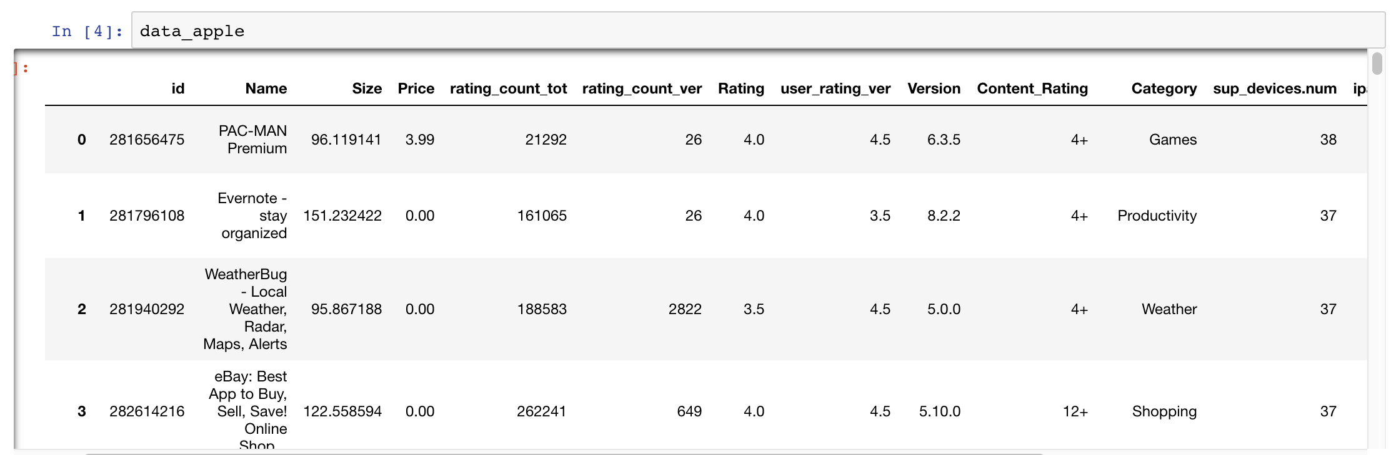
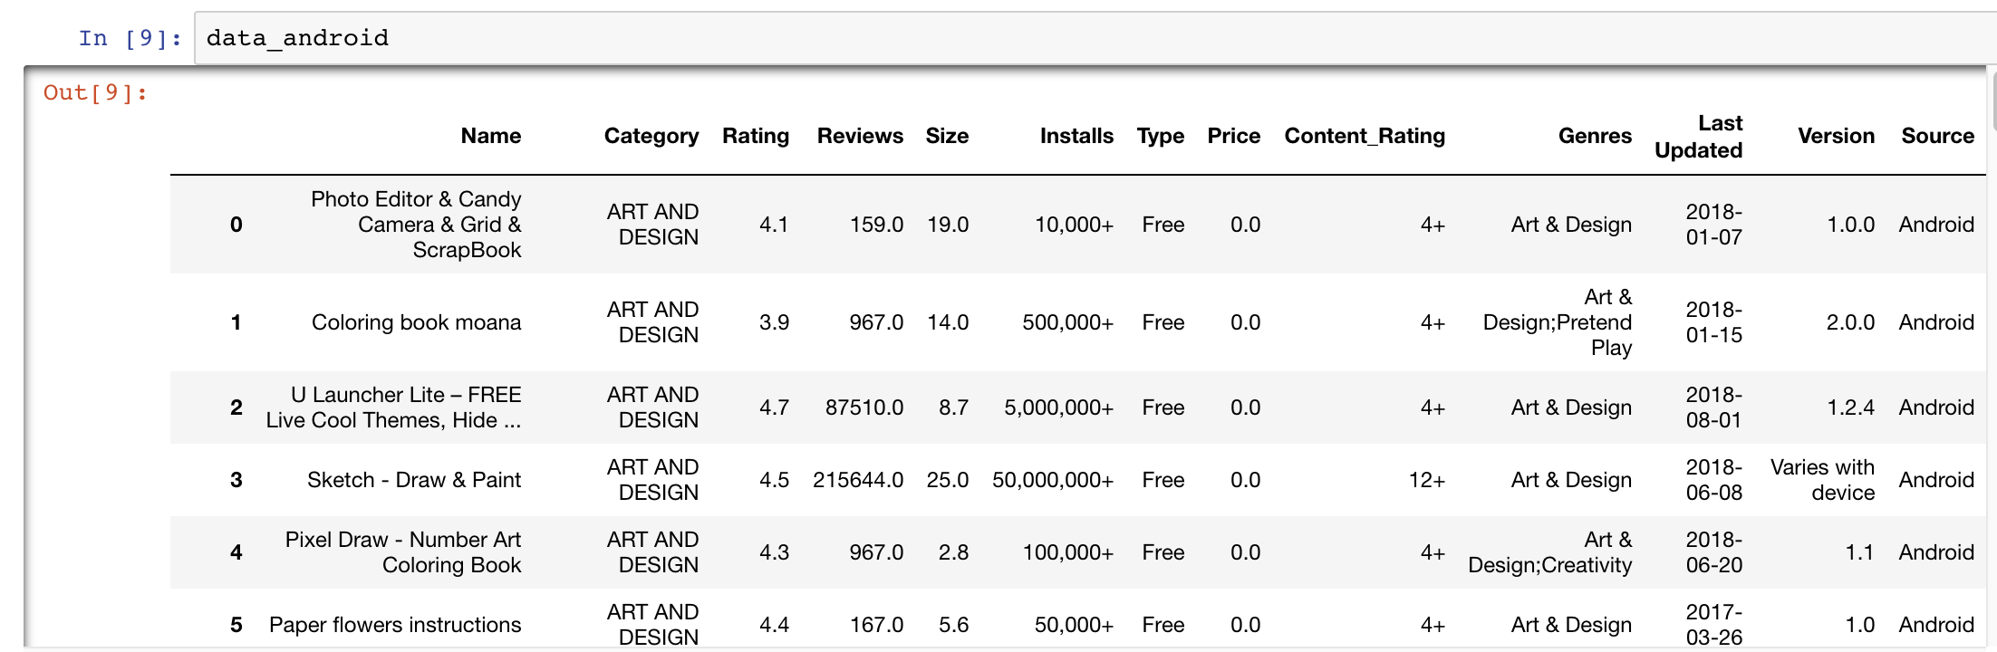
Overview of the Dataset for Apple Store and Google Play
Features: Price, Rating, Category, etc..
Original Datasets from two Kaggles datasets
Notes:
Data

Slide 4
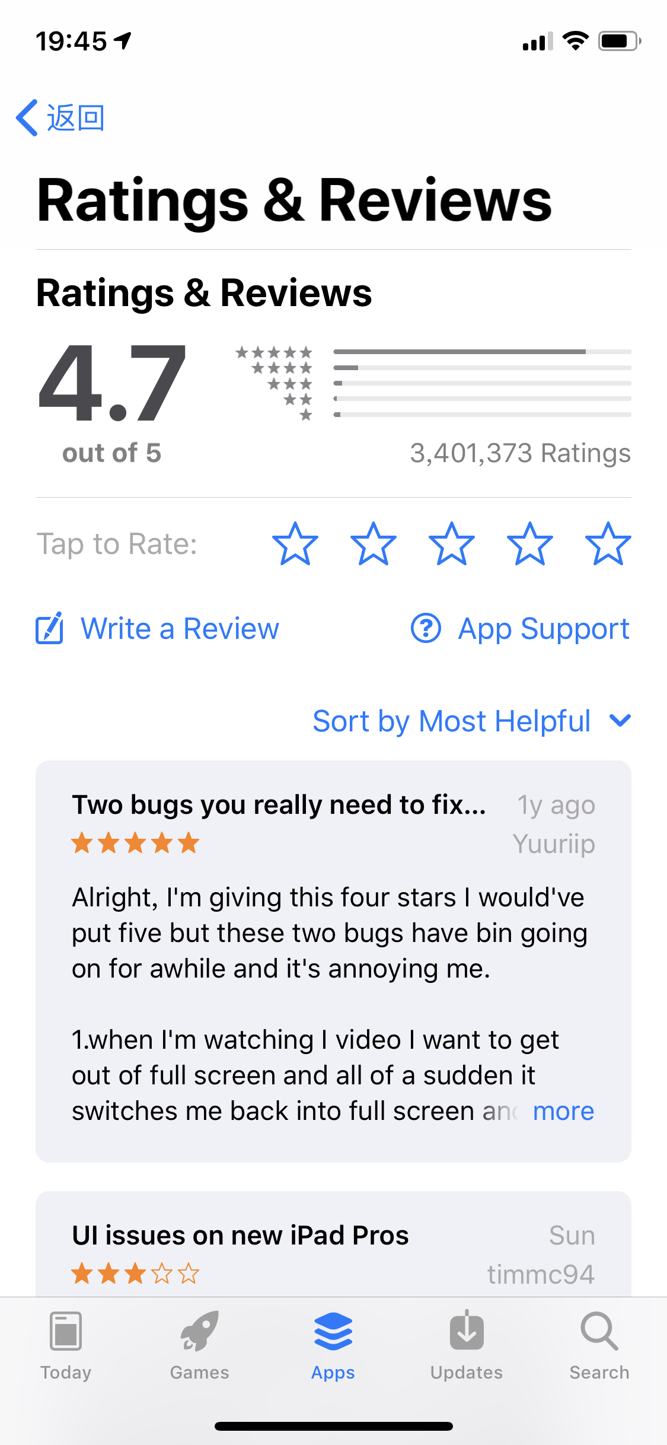
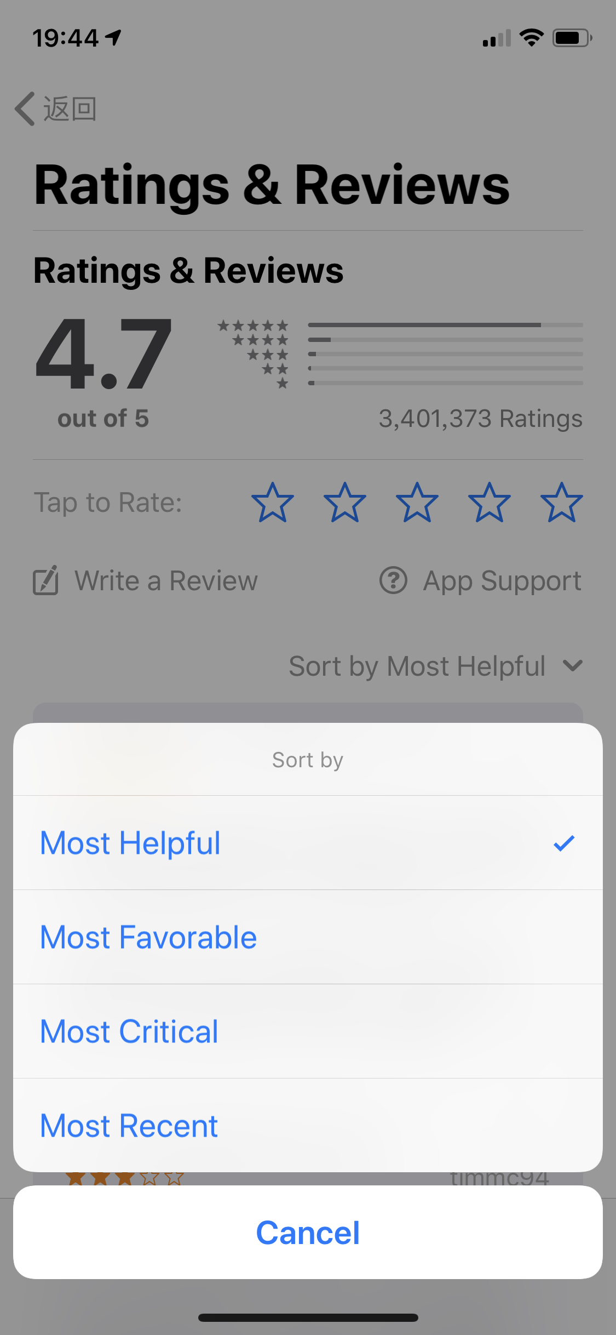
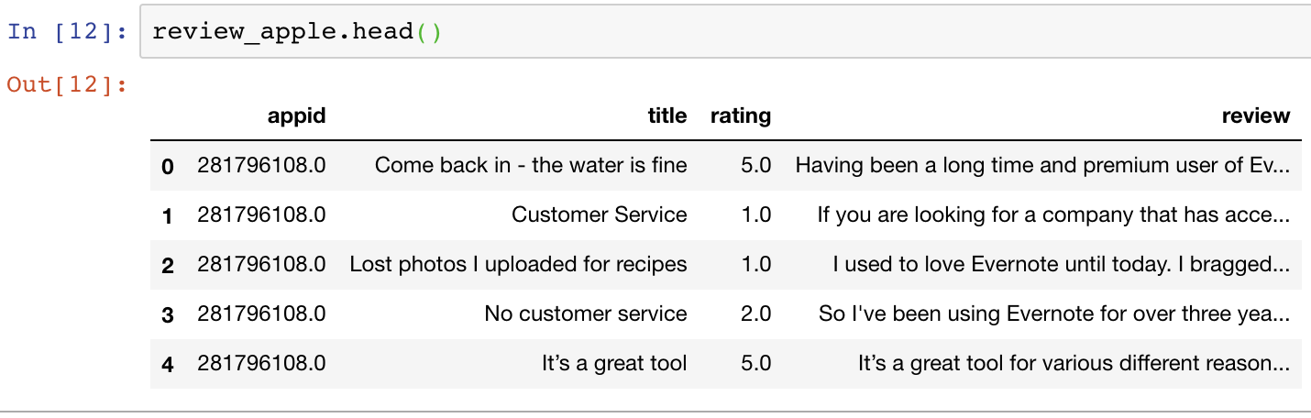
What people tend to say when they try to rate an App?
Web Scrapping of reviews:
For each App: 50 most helpful reviews defined by Apple.
From ITunes RSS Generator API
Notes:
Data

Slide 5
Word Cloud for 5 Star Reviews:
Most of them are praises:
Awesome
Amazing
Excellent

Slide 6
Word Cloud for 1 Star Reviews:
After we filter words like “Terrible”, “Horrible”, “Bad”.
We find some major complains:
not interesting
Waste time or money
Many ads
Bugs, Crashes, Rip off, Scam
No sound

Slide 7
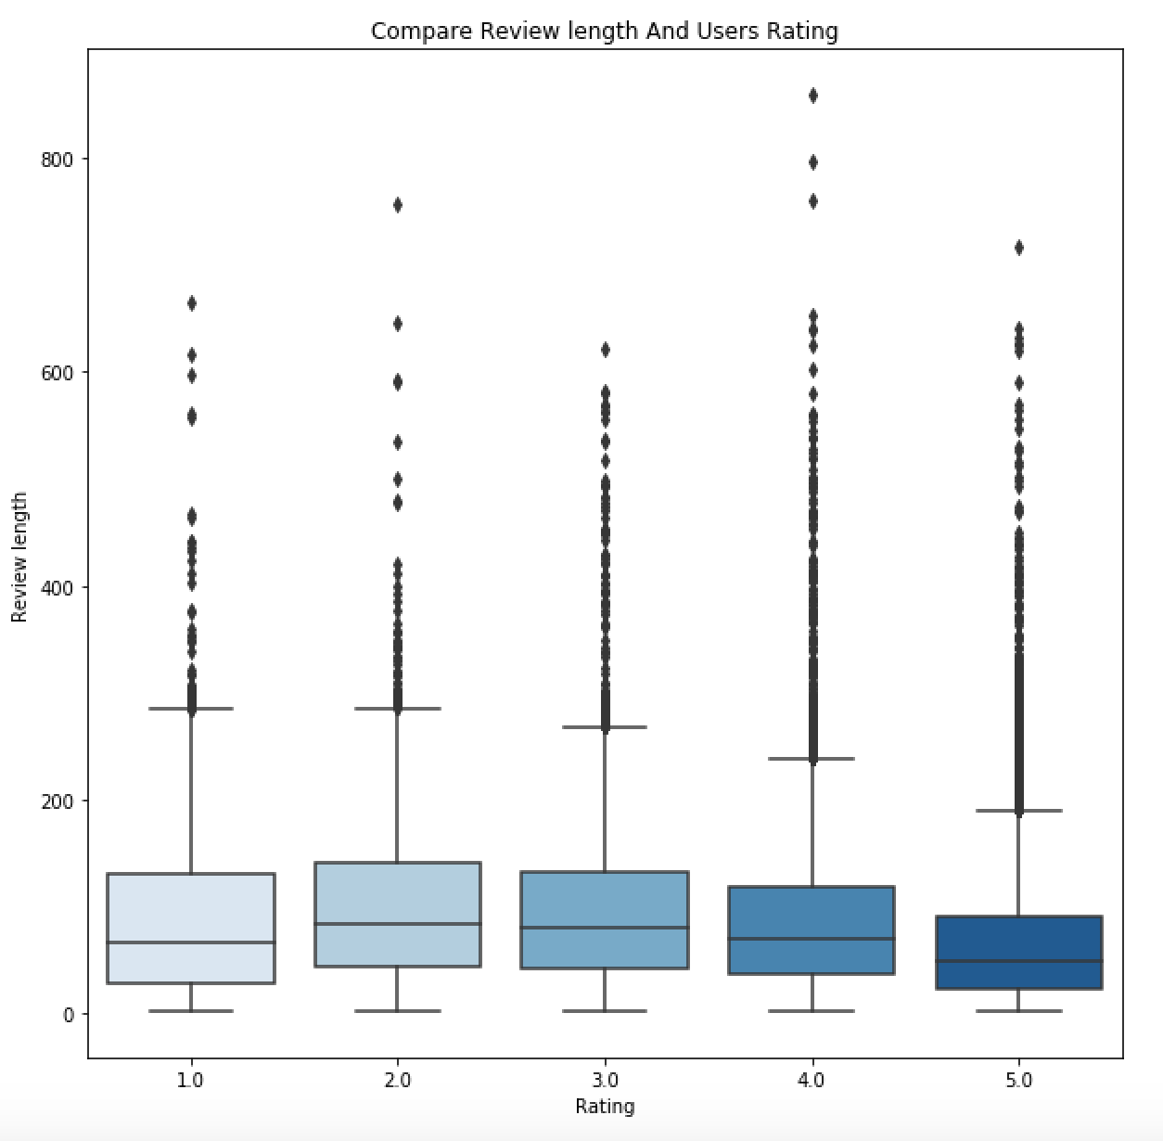
How many words people prefer to type in each rating group?
Rating Group | Review length median
1 | 65
2 | 83
3 | 79
4 | 69
5 | 48
For those people who give 5 stars, they tend to type less words. We think this is because they are very satisfied and don’t have too much suggestions to give. For people who give 1, 2, or 3 stars, their range of upper 50 percent are wider, this means those people tend to give more suggestions in their review.

Slide 8
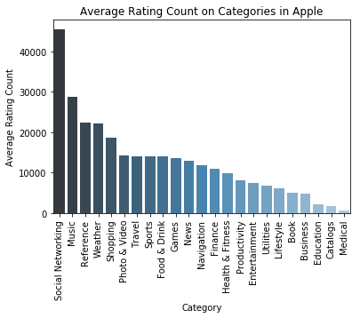
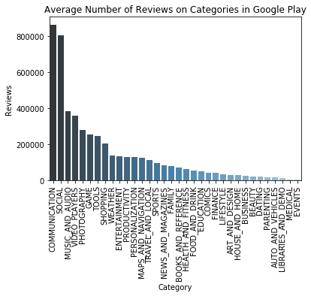
Average Rating/Reviews in both market
People are more likely to rate/comment on Social and Music Categories for both markets

Slide 9
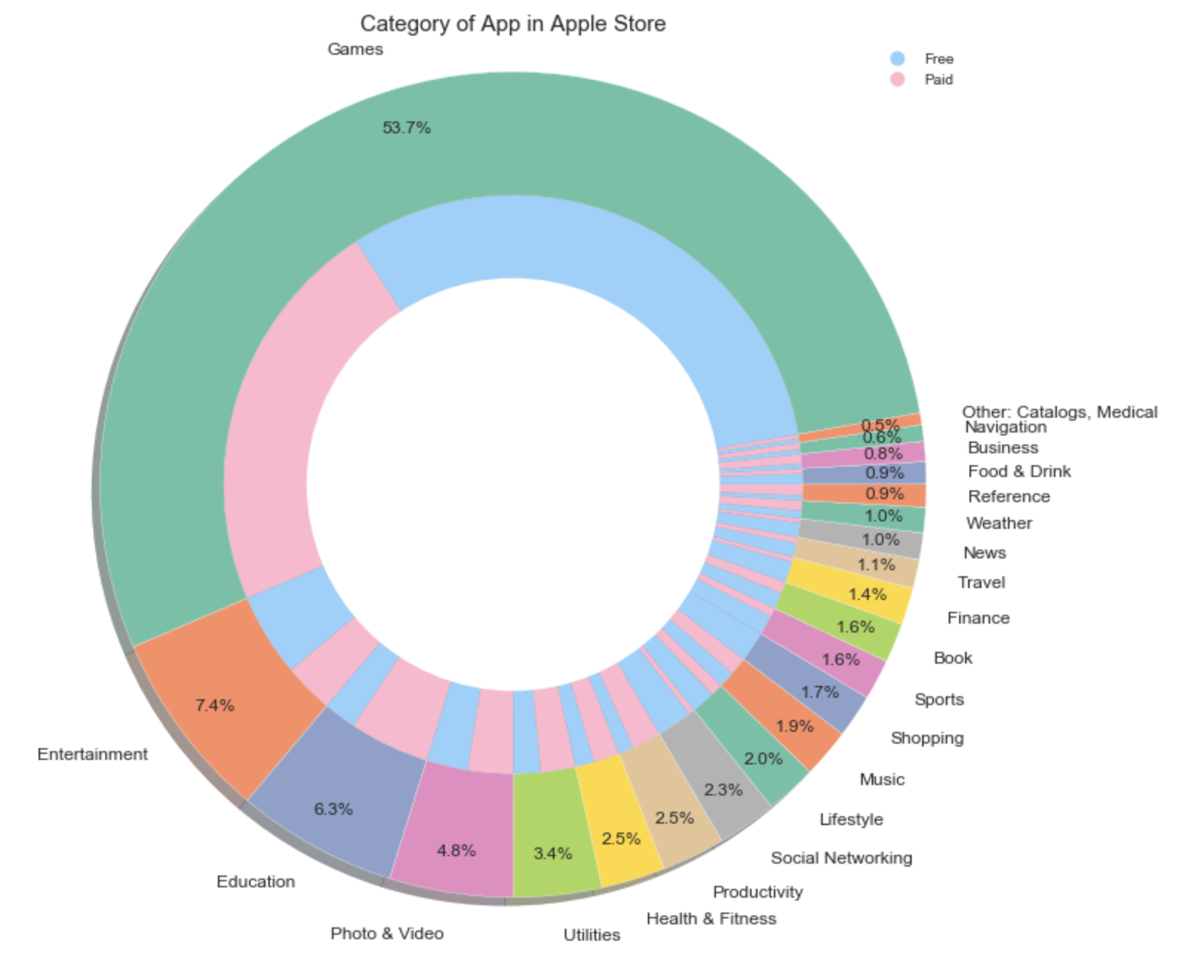
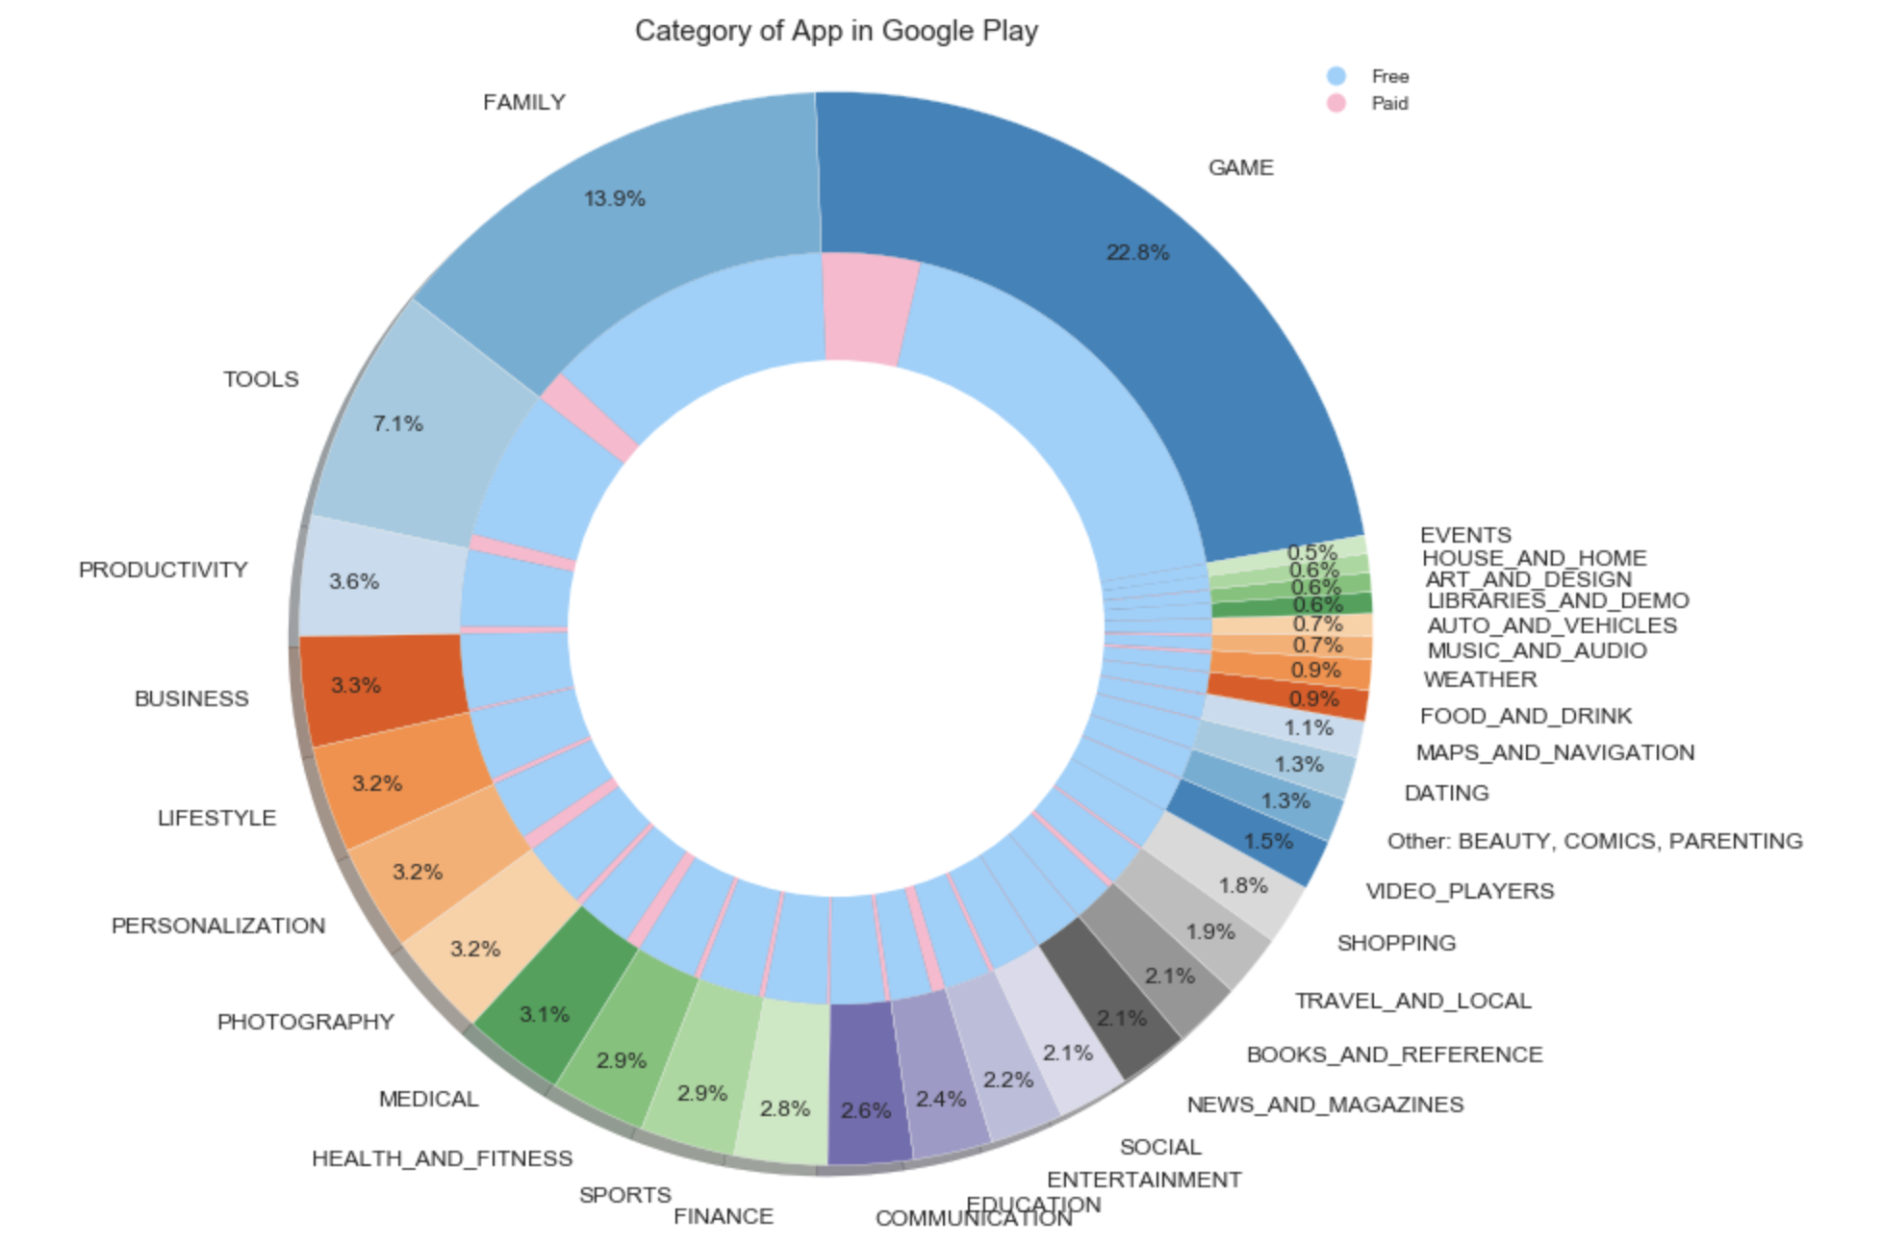
Category & Price for Apple/Google Play

Slide 10
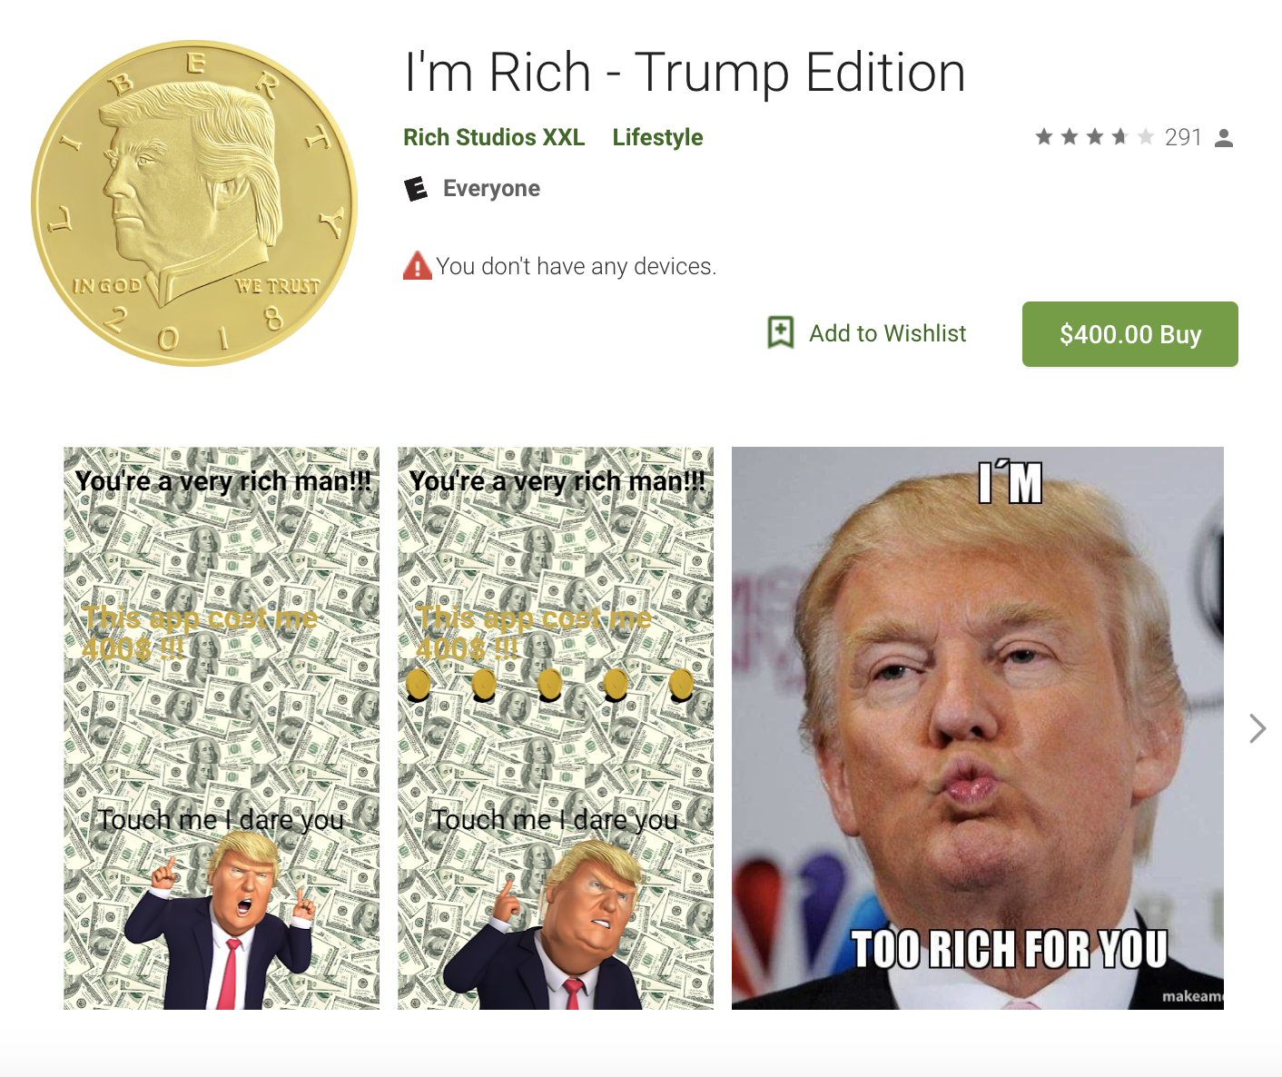
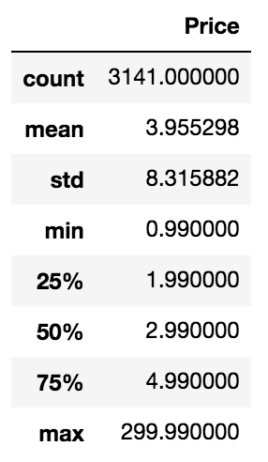
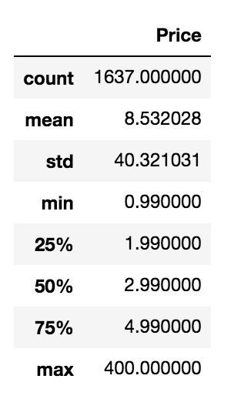
Price Distribution
Both stores’ interquartile range is 1.99 to 4.99 dollars
Google play has much higher standard deviation
Apple has more paid App
Apple Price Distribution
Google Play Price Distribution
The most expensive App in this Google Play store dataset

Slide 11
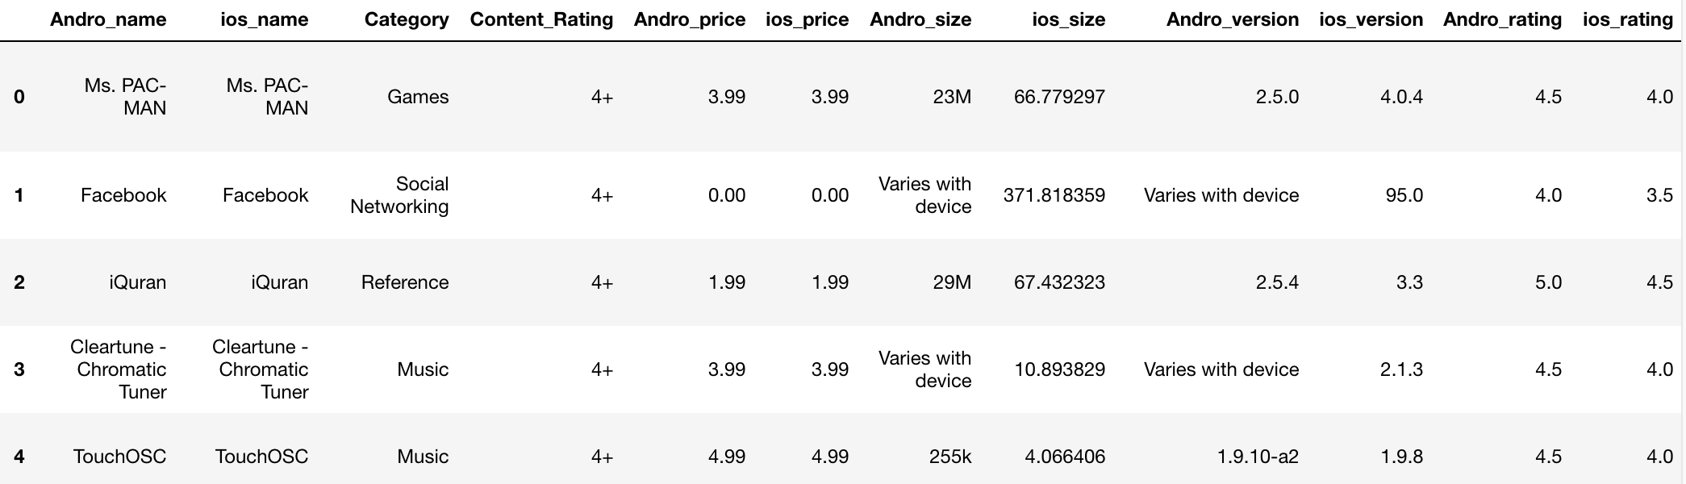
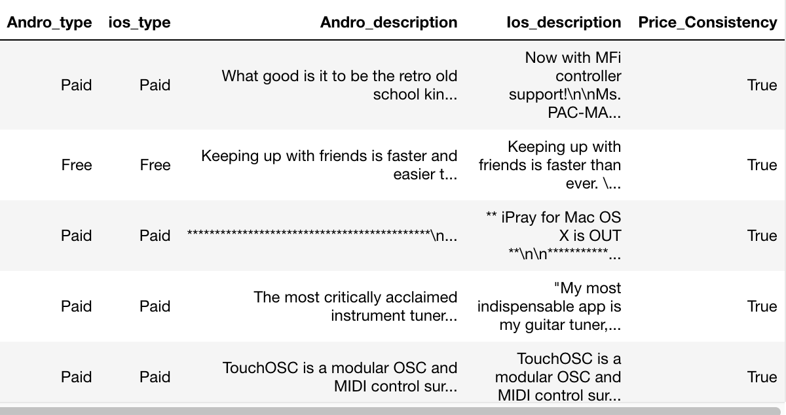
After roughly analyzing Apps in IOS and Android market separately, we are interested in whether the same App performs differently in both market?
Therefore, we scrape more Google play data base on the name in our Apple dataset to find some apps in our apple dataset which also released in Android market, there are 1600 of them. We combine them:

Slide 12
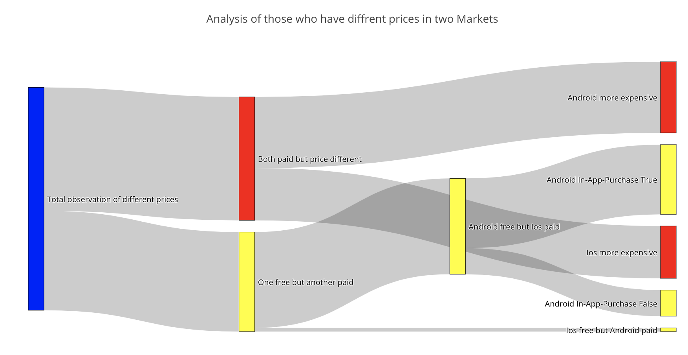
Among those apps released in both market, we find an interesting phenomenon: in every 5 of them, there are one have different prices in these two market. Why this happens?
we draw a Sankey diagram for those same app but have different prices in two market:
From this diagram, we can find that there is a huge difference in number when one is free but another is paid. For those in Android free but iOS paid, there are 132 observations, but for those in iOS free but Android paid, there are only 5. we continue to study and find that for those 132 observations, ¾ of them have In-App-Purchase. We guess that maybe in android market,.
98
170
307
170
96
307
132
132
137
72
137
36
5

Slide 13
Conclusion & Future Plan
App developers are more willing to set free download of their app at first in Android market than in iOS market to attract customers, and use other methods like in-app-purchase to make profits.
More exploration on both Markets
Relationships between Reviews and Rating
Classify the review into positive/negative based text itself (Sentiment Analysis)

Slide 14
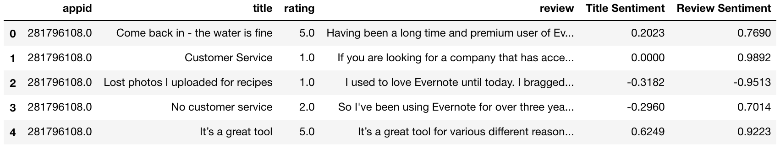
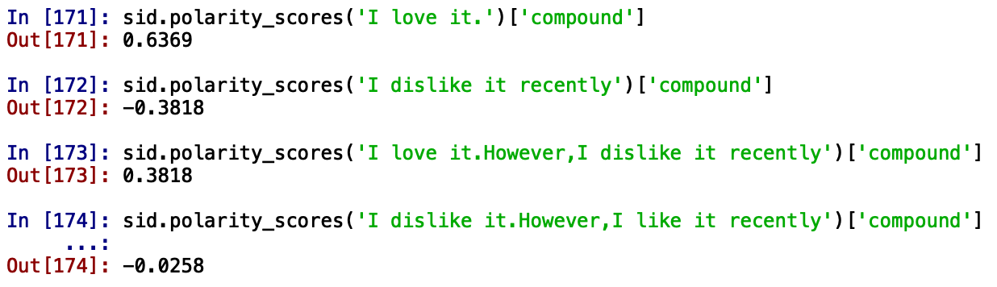
Sentiment Analysis Plan:
We find the problem is that:
It works well for a single meaning, but when it faced with some turning point, it cannot catch the more important part of the sentence:
We try to do the sentiment analysis (close to -1 negative, close to 1 positive) for those review and title of apple apps. It works well for title, but for review…… not good.
Thus, in the remaining time, we plan to analyze more about why some of our sentiment does not match the rating. Whether the user give wrong rating or wrong review? Whether our sentiment analysis have some constrains? Or whether that sentence cannot be decided without context?

